Slide 1
EFFECTIVE CRIME CONTROL USING GEOGRAPHIC INFORMATION SYSTEMS(GIS)
Researchers: DARKO ISRAEL ABBEY & NTI OHENEBA ISRAEL
Supervisor: DR. ISAAC DADZIE

Slide 2
Outline
Introduction
Problem Statement
Aim & Objectives
Literature Review
Previous Research
Resources and Materials
Methodology / Flow chart
Expected Outcome
Study Area

Slide 3
Introduction
Crime, the intentional commission of an act usually deemed socially harmful or dangerous and specifically defined prohibited, and punishable under criminal law (David A. Thomas, 2020).
Crime has an inherent geographic quality.
The processes used in tackling crime in Ghana is cliché hence the need to pick up this project so as effectively combine the traditional methods and the new technology to curtail crime in our society.

Slide 4
PROBLEM STATEMENT
Crime is gradually dominating our cities and this can be linked to rapid urbanization.
Our policing system has still not evolved hence tackling crime is still a challenge.

Slide 5
AIM
The aim is to produce a GIS interface that aids in investigating and reducing crime in the metropolis and hopefully the nation as a whole.

Slide 6
OBJECTIVES RESEARCH QUESTIONS
To provide a revised map showing the distribution of crime hotspots in the metropolis so as to help law enforcement agencies use their resources effectively.
To design a statistical analytic tool to show the most probable crime kinds that have happened over the years
To create a map for the civilians to know the types of crime in their surroundings so they can work hand in hand with law enforcement agencies to reduce crime.
To provide tips for self defence mechanisms against crime.
How will the law enforcing agencies visualize crime in Kumasi Metro?
How can we help the police in crime control decision making?
How will the civilians know the types of crime in their surroundings?
How will citizens protect themselves and their properties?

Slide 7
LITERATURE REVIEW
Crime Control
Geographical Information Systems (GIS)
Components of GIS
Maps
Digital Mapping
Understanding Crime Hotspots

Slide 8
PREVIOUS RESEARCH WORKS
There is a large volume of literature relating to the use of GIS in policing crime.
One of these works was on Geospatial mapping of hotspots of crime within Kumasi Metropolis by Daniel Anongeriba and Victor Baba Atiniak.
Published in June 2020.
Their work focused on displaying the hotspots of crime in the metropolis by processing crime data in ArcGIS to produce a map.
The results produce did not reflect on how the civilians should protect themselves by having knowledge of the map.

Slide 9
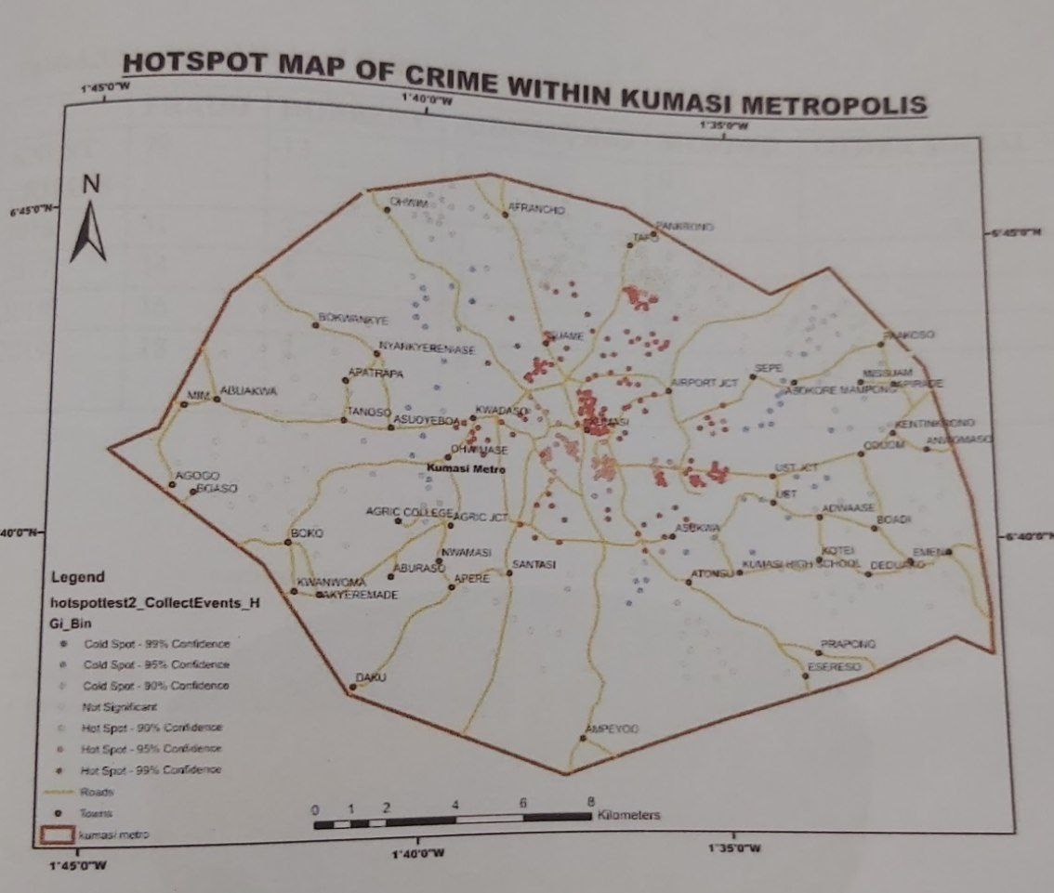
RESULTS

Slide 10
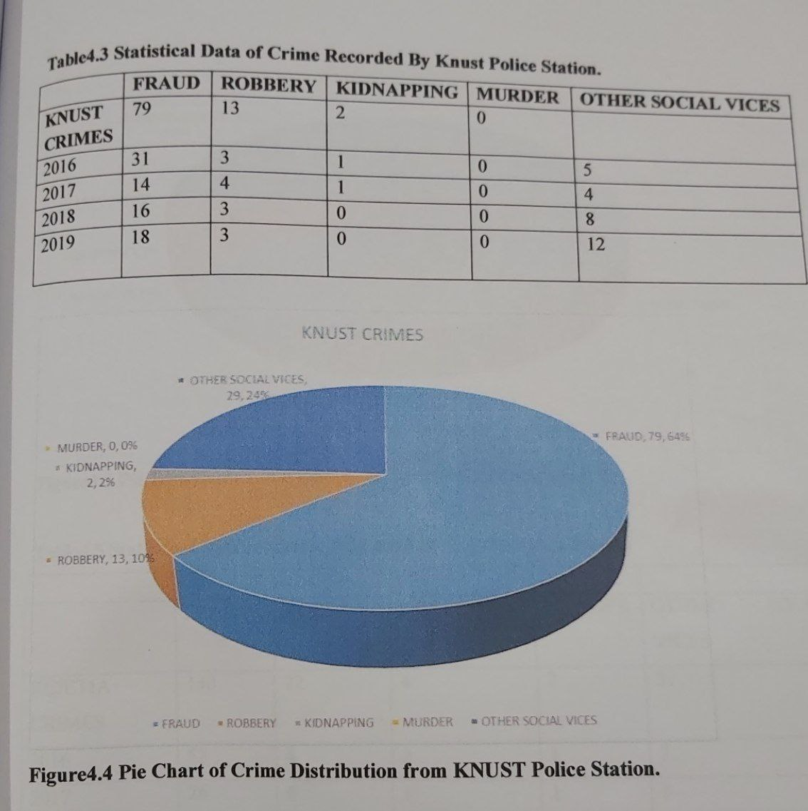
RESULTS

Slide 11
PREVIOUS RESEARCH WORKS
Another publication written on the topic, Crime mapping as a tool for security and crime prevention by Kate Bowers and Shane D. Johnson.
They based their research on a survey conducted in 2005 by the Home Office Survey.
The questionnaires contained questions on how crime mapping affects the work of security and crime control.
The data processed produced a thematic map within the metropolis police beat. They also produced a point map containing individual crime locations.
The civilians were able to access the crime map on the internet but this goes against the geo-privacy of the civilians.

Slide 12
PREVIOUS RESEARCH WORKS
Another publication written on the topic, Crime mapping: Using Geography to Plan Policing by Confins in 2019.
The aim of this work was to produce a spatial representation of bank robberies in Rio, Brasil.
The data processed included shape files of the road network, number of robberies and police beats.
This work provides only spatial patterns as illustrated by the colors in their results.
Their work lacks the time aspect of crime events which could be represented by graphs. Crime control plans are more effective when time and space are combined

Slide 13
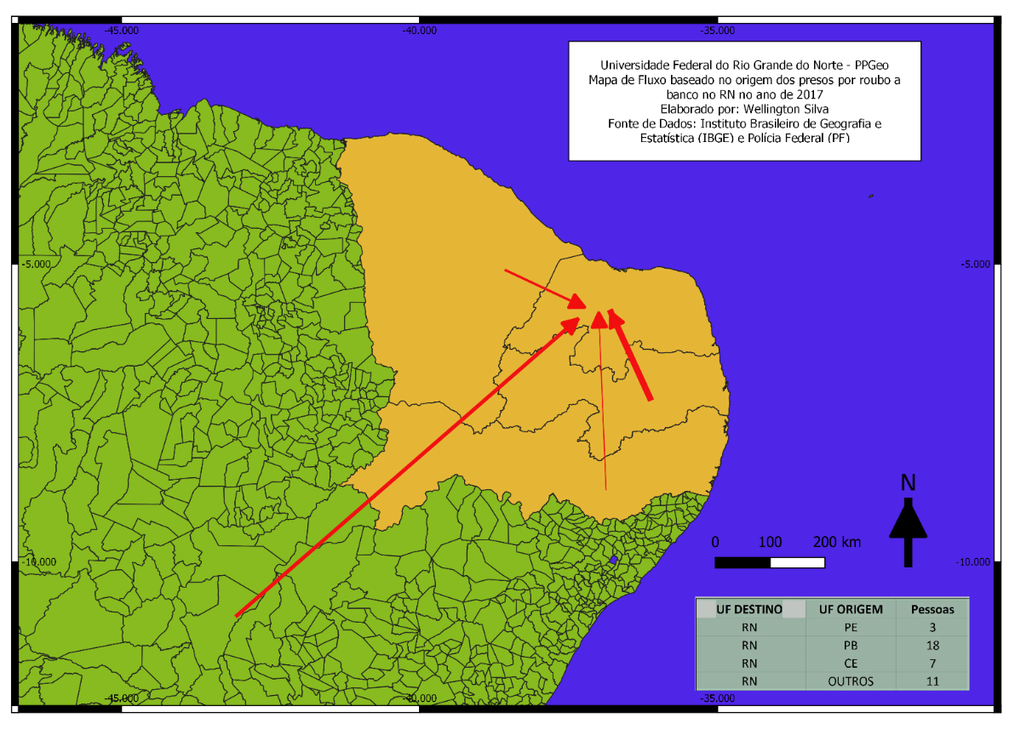
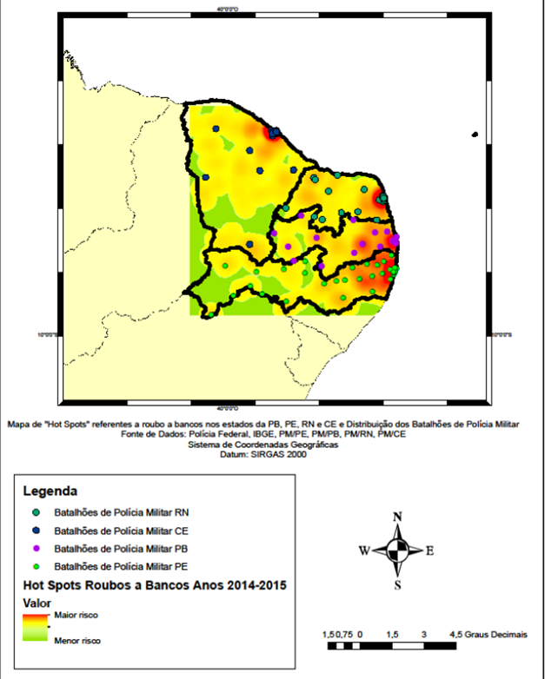
RESULTS

Slide 14
RESOURCES & MATERIALS
Hand held GPS
ArcGIS
Microsoft Excel
Open Street Maps
Google Earth

Slide 15
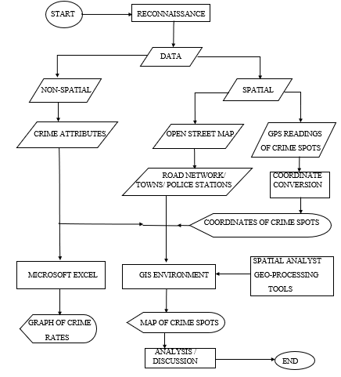
PROPOSED METHODOLOGY
DATA
ACQUISITION
DATA
PROCESSING
RESULTS

Slide 16
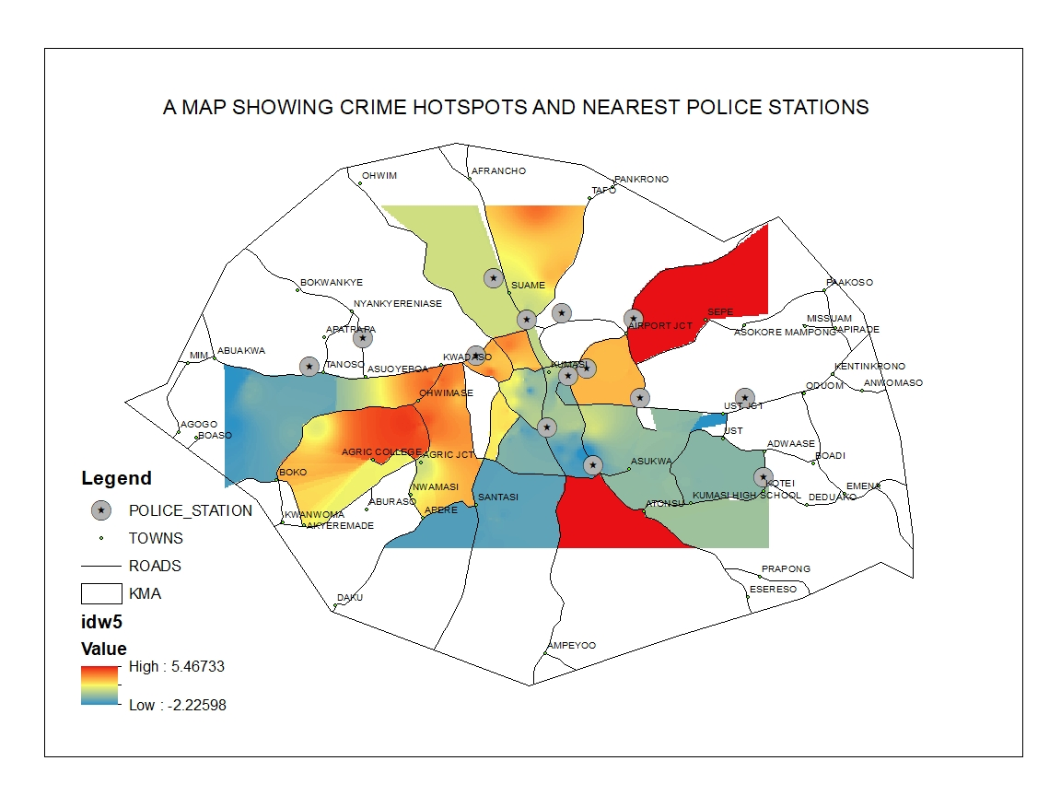
RESULTS

Slide 17
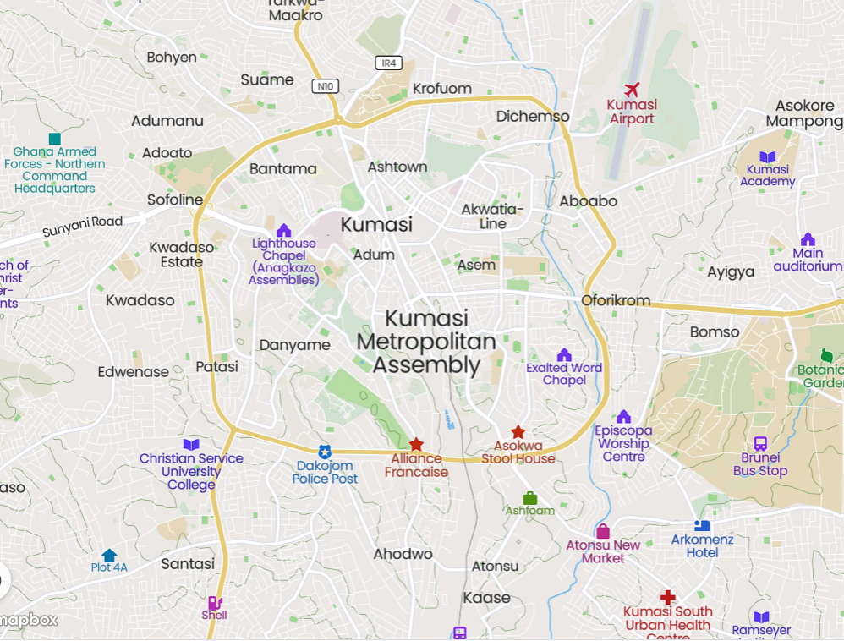
STUDY AREA

